Slide 1
Design of Attendance Checking Management System Based On Fingerprint Recognition
RDBMS IA-I
Shubh Gosalia
1911015

Slide 2

The Traditional System Of Marking Attendance
Over the years, educational institutes pan India have manually checked and marked the attendance of students.
Roll call of the entire class is taken and accordingly the attendance roster is filled.
The professor in charge has to maintain the attendance records on a daily
basis for every class that he/she is attending to.
On basis of that, the attendance report is prepared for the
ongoing semester.
However, is this method which is still prevalent in many institutes even
today, that efficient?
No.

Slide 3
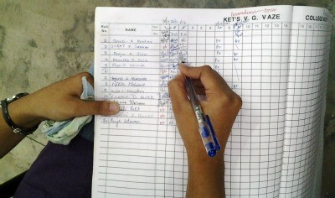

Discussing The Drawbacks
Since the attendance is taken within the lecture hours, it eats up a lot of time.
Human errors are bound to be committed.
Additional workload to the faculty.
Daily cases of proxy.
Low efficiency and accuracy.
Overall, all these factors are not conducive in managing students’ attendance.
The need for a specialized attendance management system is what required in these times.
So, how is that possible?

Slide 4
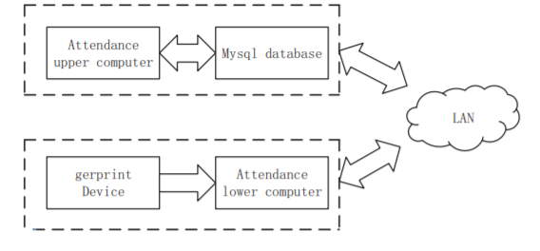

Attendance Management System Based On Fingerprint Identification
So What Does This Do?
This system carries out fingerprint information storage, transmission, check-in information query, statistics and other functions which are done through fingerprint collection, comparison, identification, database establishment, data transmission and design of upper and lower computer interface.
Design Scheme
The program design of the system is mainly divided into 4 modules:
Fingerprint collection and comparison
Reading and Writing a Database
Network Connection
Design of upper and lower computer interfaces

Slide 5
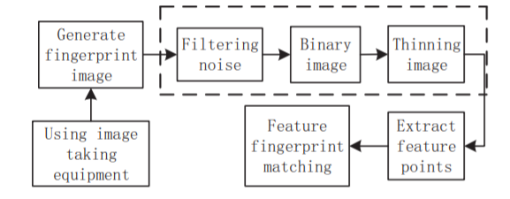


System Design – Lower Computer
Consists of three parts : fingerprint information collection and attendance, login interface and design of database.
Fingerprint information collection is further divided into three processes: fingerprint template collection, feature extraction and fingerprint recognition.
Now, fingerprint recognition consists of two processes, registration and recognition process.

Slide 6
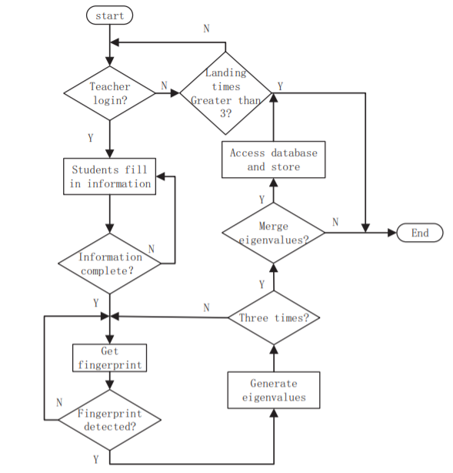
Student Registration Process
First, the teacher logins from the teacher’s login interface.
Then, in the student interface, students fill in their personal information such as student name, roll no., gender, major and class.
Next, three fingerprint acquisitions are combined to form a string template
Registration successfully completed and the corresponding student information is written into MySql database to complete fingerprint collection and storing process

Slide 7

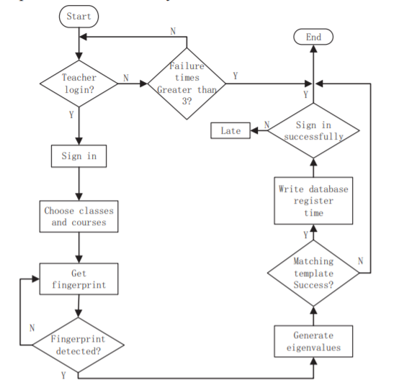
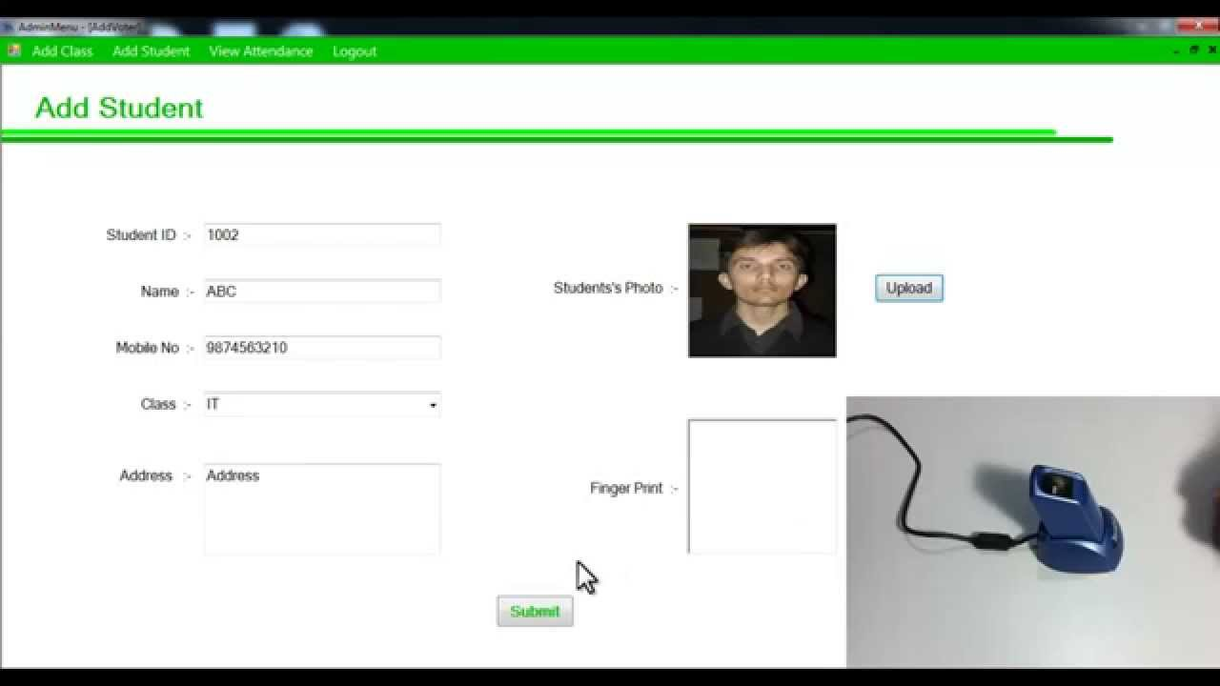
Student Attendance Process
Students select the class and the course to be signed in
The, they enter their registered fingerprint which is compared with the fingerprint template
If matched, the attendance time information is wrote into the time column in the attendance database

Slide 8
System-Design – Upper Computer
The Upper computer, operated by the administrator, mainly completes the query of sign in information divided into teacher and student query.
If the teacher inquires, it inputs the registered name and the password.
Similarly, if a student inquires, it inputs the student number and password
All the inquiry information includes: class, name, student number, course, check-in times and late times.

Slide 9

Database Design
Database Design forms an important part of the system, mainly responsible for the storage of fingerprint attendance data and the login information of students or teachers

Slide 10
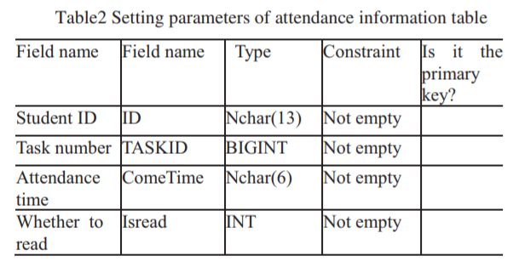
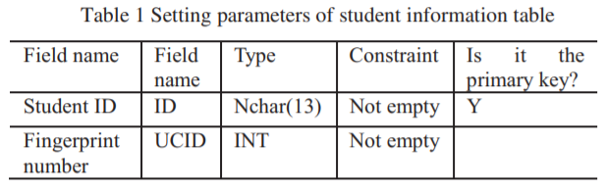
So How’s The Database Model Constructed?
In the entire attendance system, the main objects in the database are: students, teachers, administrators and the specific information of fingerprint attendance
The relationship model associated with:
Student: student number, name, fingerprint information and login password.
Teacher: name, password, course taught.
Administrator: times of attendance.
Attendance information: date and serial no., student number, attendance time, absent or not.

Slide 11
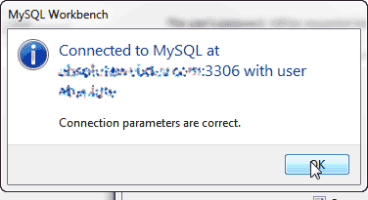
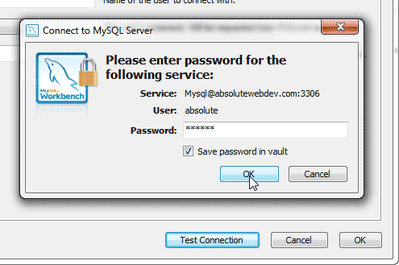
Database Connection
The Upper and Lower computer is connected with the database respectively to complete the storage and transmission of information
Once the fingerprint attendance meter collects information, the string generated will be stored through the following database connection code:
StrConn = "DRIVER={MySQL ODBC 5.3 ANSI Driver};"
& _
"SERVER=" & db_host & ";" & _
"DATABASE=mysql;" & _
"UID=root; PWD=root; port=3306"

Slide 12

Data Transmission
In class, students check their attendance on the fingerprint acquisition device connected to the teacher’s computer, and transmit the information of the attendance (attendance date and time, name, student number, etc.) to the central server in real time through the school LAN.
The central server is also a server for student attendance information management, through which the school’s academic administrators can query the attendance of each student, as well as the current class and time of the students.

Slide 13
Implementation Strategy
Will be implementing the Database part of the Research Paper which includes:
ER model of the system
Mapping of ER model to Relational Model
Creation of student, teacher, administrator and attendance information tables
Database Connection(J-connector) and building a console based java application
Executing Queries

Slide 14
Conclusion
This system meets the needs of teachers, and designs a class attendance system composed of fingerprint instrument, upper computer and lower computer.
Students only need to register their fingerprint information once, and then they can carry out fingerprint attendance permanently.
The academic affairs office can easily query and manage the students’ attendance thereby saving the teachers’ manual roll call in class and reporting attendance to the higher authorities.
This system is convenient, fast and time-saving. It has advantages of strong practicability, wide range of use, easy expansion, low cost of installation and maintenance, and has a long-term development prospect.
It can be widely used in many fields, such as public security, banking and computer network information security and so on.

Slide 15
References
http://ieeexplore.ieee.org.library.somaiya.edu/stamp/stamp.jsp?tp=&arnumber=9164638 (Research paper by Dongmei Feng, Peng Wang, Lei Zu)
MathStackExchange and Geeksforgeeks websites
Nevon Projects(Youtube Channel)
http://edelweisspublications.com/edelweiss/article/Automated-Student-Attendance-System-using-Fingerprint-Recognition-2576-8484-EAST-18-120.pdf( Research Article)
www.google.com

